Slide 1


The Shakespeare Folios Project
State University of New York at New Paltz
John Berean
Project Type: Internship
Class Key: s19-03

Slide 2
Business Context and Goals
The Shakespeare Folios Project is an editable Web-based Database that seeks to identify all existing copies of Shakespeare’s Second, Third, and Fourth Folios.
Why?
The First Folio has been thoroughly studied and counted, and thanks to the work of generations of scholars, we know how many copies exist today (around 235) and where they are located.
But we don’t know how many copies of the later folios there are. Scholars make assertions about the scarcity of the Third Folio, but is it actually scarce?
If we want to study how Shakespeare’s publications evolved and how they were used, we need first to identify where to find them.

Slide 3
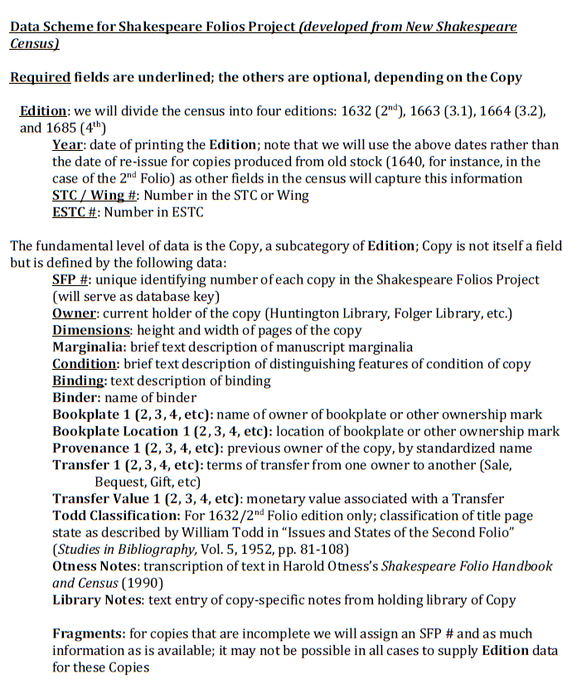
Shakespeare Folios
After William Shakespeare died in 1616, two of his friends decided to publish his works.
They collected his plays and brought them to publishers Edward Blount and Isaac Jaggard, who then began to make the First Folio.
The term folio refers to the large size of paper, which was usually saved for more important documents like theology, history, and royal proclamations.

Slide 4
System Background Information
The system will be used by literarians, scholars and people interested in evolving the recorded information regarding Shakespeare’s 2nd, 3rd and 4th folios.
The system will have world wide accessibly and use.

Slide 5
Front-End Development
HTML
CSS
Bootstrap

Slide 6
Back-End Development
MySQL
PHP
JavaScript

Slide 7
Technologies
Related Technologies
HTML, CSS, Bootstrap, PHP, MySQL
Newly Learned Skills/Technologies
Working on further developing my skills with PHP, MySQL and the intermingling of the two.

Slide 8


Software Functionalities
Our website aims to provide users with an educational and engageable platform.

Slide 9
Register & Login
Users will be allowed to register with their chosen email and password.
Once a user has successfully registered they will be able to login and logout in the future.
Registered users are the only users that will have access to adding and or editing information on the website.

Slide 10
Uploading Folios
A successfully registered user is allowed to post information about known folios copies to the website.
The user needs to provide basic information requirements but can also include more information like pictures and marginality.
Once a folio has been successfully posted it will be publicly available to view along with all other known folios.

Slide 11
Viewing Folios
Once a user has entered the website they will be able to view all uploaded folios.
Users will also be able to filter and search for entries based on specific criteria.

Slide 12
Collaborating and Editing Folios
Users will be allowed to invite other registered users to collaborate on their uploaded folios.
These collaborators may alter and or add information/pictures to the folios that they are given permission to.
Collaborators may only edit posted folios not delete them.
The deleting of folios operation is entitled to the original user that posted the folio along with editing.

Slide 13

Technical Requirements
Technical aspects that the system must fulfill.

Slide 14

System Components
User Interface:
Basic computer-window display.
Means of Interactions:
Mouse, keyboard, touchscreen.
DATA:
Format: Database Connections, MySQL Tables
Host: wyvern.cs.newpaltz.edu
Hardware: SUNY New Paltz Servers
MySQL Tables:
User (ID, email, password, folios)
Folio (ID, UserID, Collaborators, Edition, Year, ESTC#, SFP#, Owner, Dimensions, Condition, Binding)
Collaborators(ID, UserID)
Photos(ID, FolioID)

Slide 15

Processing
Register
Login
Uploading Folios
Searching
Viewing All Folios
Viewing Single Folio
Inviting Collaborators
Collaborating

Slide 16
Register Functionality
Input
First Name, Last Name, Username, Institutional Relation, Email and Password.
Process
1) Authenticate email/password is a valid , dealt with on front end. (HTML)
2) Compare in database that the users email is not present, dealt with on back end. (PHP/MySQL)
Output
i.) Fail if:
- Email is not valid. (1)
- Password length is not at least 8 characters. (2)
- Username already exists in “User” table. (3)
Send error (k) to register page => Register page.
ii.) Success => Hash users password, Inset users information into User table in DB.
Create active user session => Profile page

Slide 17
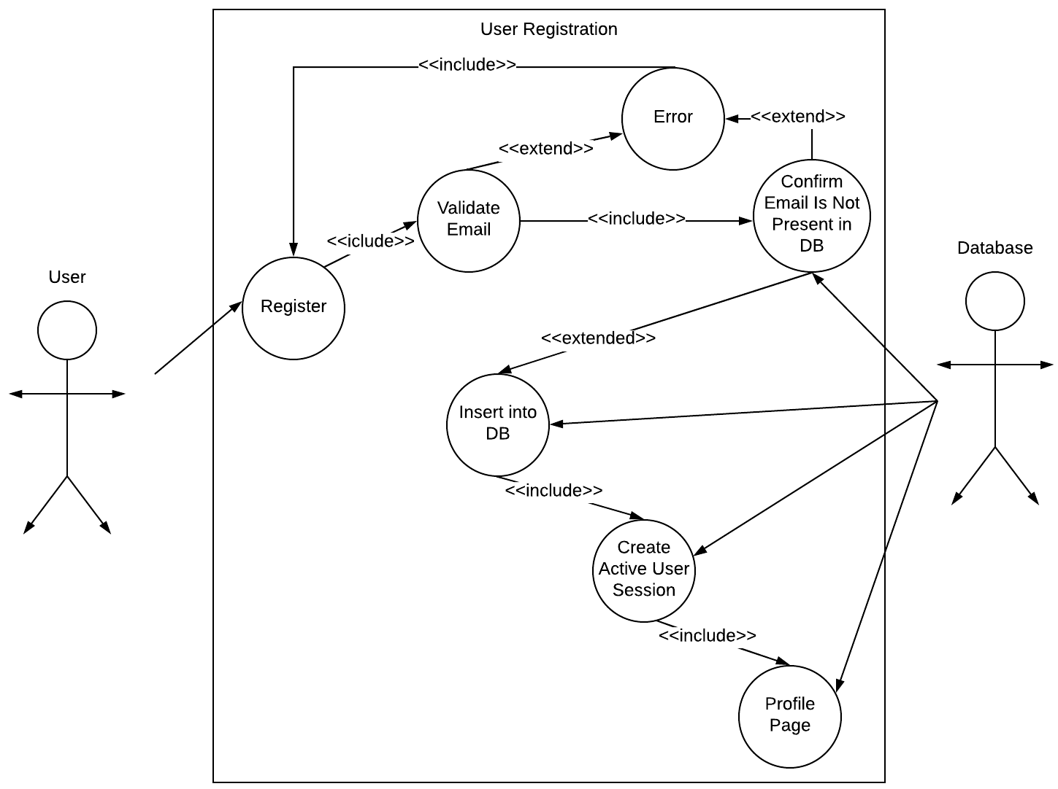
Register Use Case Diagram

Slide 18
Login Functionality
Input
Username and Password.
Process
1) Authenticate email/password is a valid , dealt with on front end. (HTML)
2) Compare data against “User” table in MySQL database. (PHP/MySQL)
Output
i.) Fail if:
- Email is not valid. (1)
- Password length is not at least 8 characters. (2)
- Invalid credentials compared to “User” table. (3)
Send error (k) to register page => Register page.
ii.) Success => Create active user session => Profile page

Slide 19
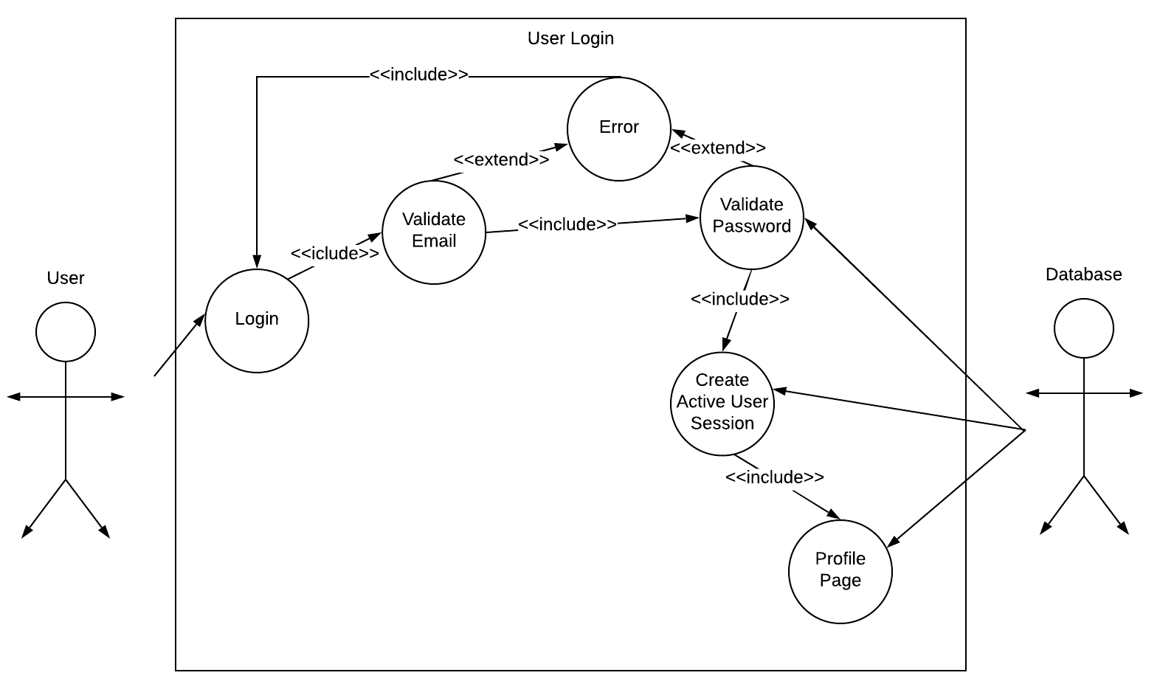
Login Use Case Diagram

Slide 20
Uploading Folio Functionality
Input
Folios information. (See Folio Data Scheme for information)
Process
1) validate that the limited required fields have been inserted, dealt with on front end. (HTML)
Output
i.) Fail if:
- Minimum required fields have not been met. (1)
- Folios SFC number is identical to one in the server. (2)
Send error (k) to upload page => Upload page.
ii.) Success => Insert folios information into “Folio” table. => Profile page
2) Confirm the SFC number is unique, folios is not already present in the database. (PHP/MySQL)

Slide 21
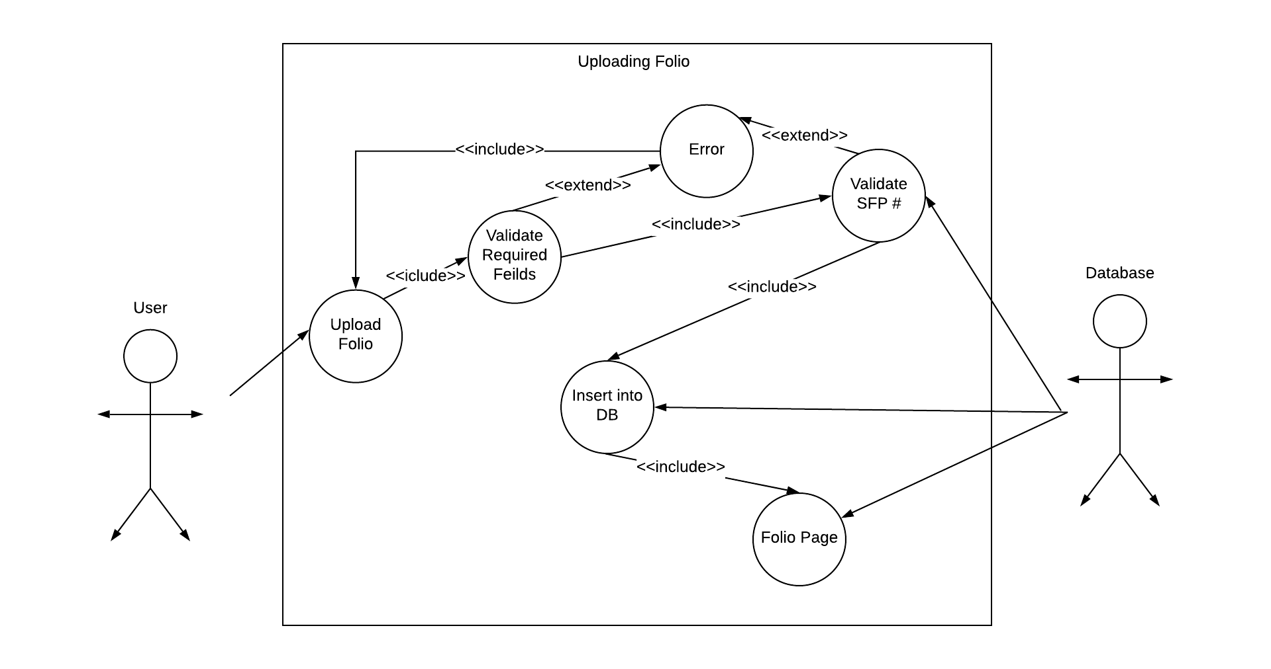
Uploading Folio Use Case Diagram

Slide 22
Inviting Collaborators Functionality
Input
A registered users username.
Process
1) Confirm the users username exist in the “Users” table. (PHP/MySQL)
Output
2) Confirm the users username does not exist in “Collaborators” table. (PHP/MySQL)
i.) Fail if:
- Username does not exit in “User” table. (1)
- Username already exists in “Collaborators” table. (2)
Send error (k) to upload page => Upload page.
ii.) Success => Insert chosen username into the “Collaborators” table => Folio page

Slide 23
Collaborating Functionality
Input
Additional folio information.
Process
1) Confirm the users username exist in the “Collaborators” table. (PHP/MySQL)
Output
i.) Fail if:
- Username does not exists in “Collaborators” table. (1)
Send error (k) to folio page => Folio page.
ii.) Success => Insert updated information into the “Folios” table => Folio page

Slide 24
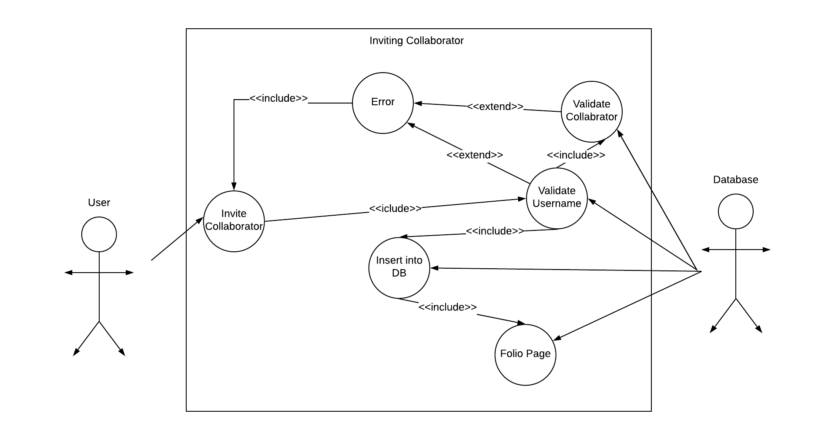
Collaborator Use Case Diagram

Slide 25
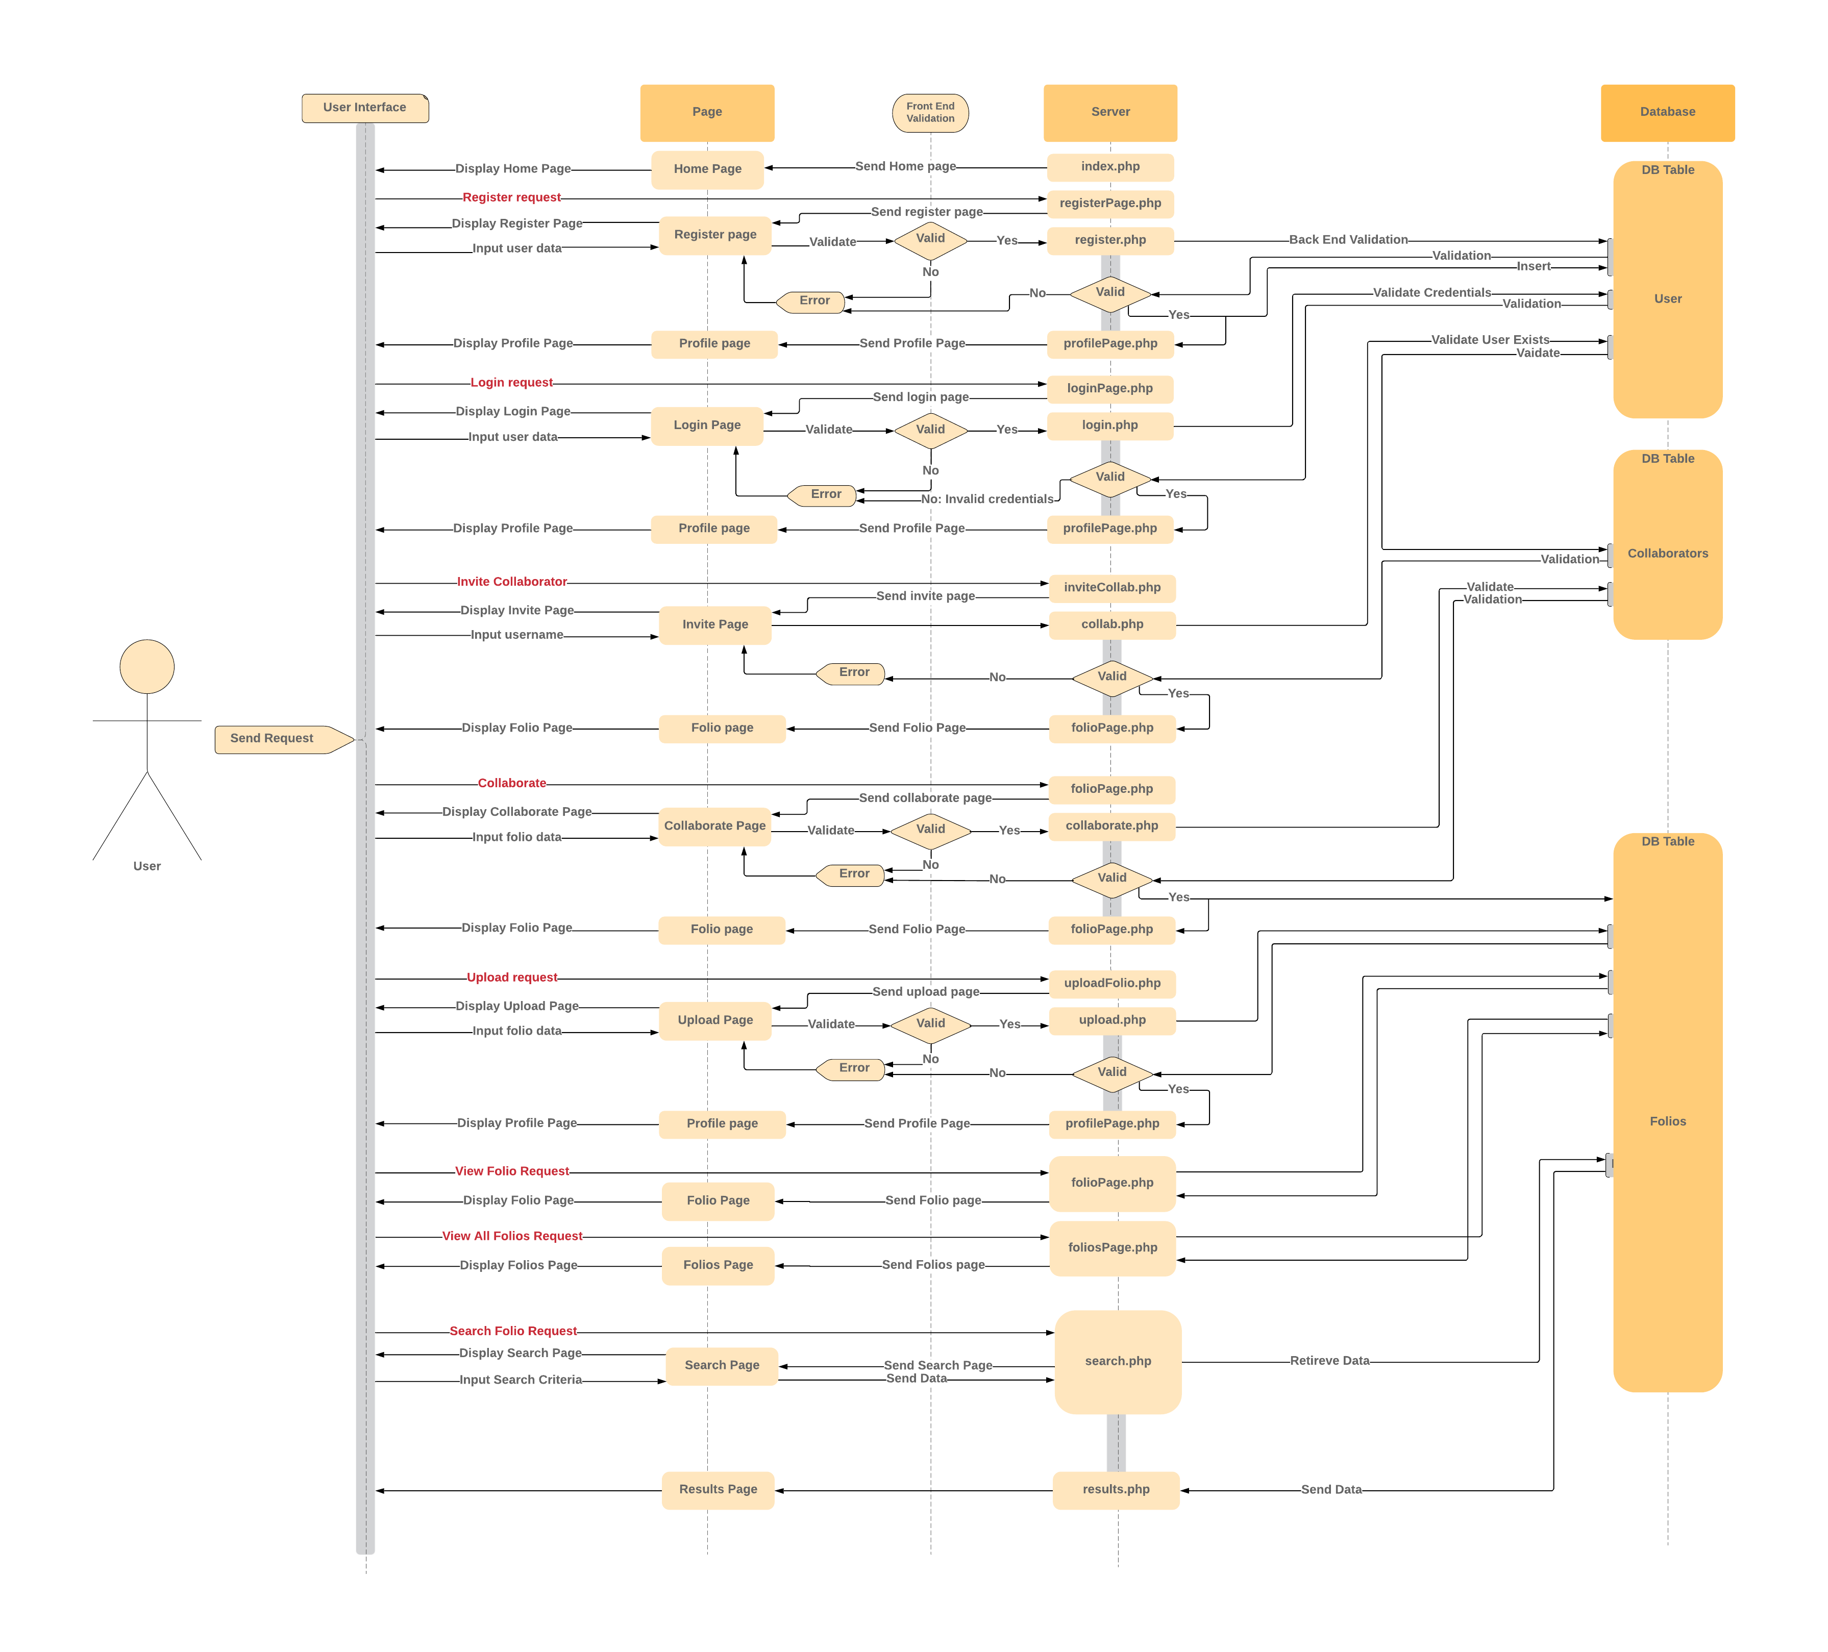
Architecture

